Slide 1
The TINY Language
Syntax description
A program is a sequence of statements separated by semicolons
Declarations
No procedures and no declarations
Data Type
All variables are integer variables, and variables are declared by assigning values to them

Slide 2
Statement
Two control statements: if-statement and repeat-statement, read and write statements
Expression
Boolean and integer arithmetic expressions
Comment
Comments are allowed within curly bracket

Slide 3
Example
{sample program in TINY language- computes factorial}
read x; { input an integer }
if 0<x then { don’t compute if x<=0 }
fact:=1;
repeat
fact := fact*x;
x := x-1
until x=0;
write fact{output factorial of x}
end

Slide 4
Syntax of the TINY Language

Slide 5
A Context-Free Grammar for TINY
program -> stmt-seq
stmt->seq -> stmt-seq;stmt | stmt
stmt -> if-stmt|repeat-stmt|assign- stmt|read-stmt | write-stmt
if-stmt ->if exp then stmt-seq end
| if exp then stmt-seq else stmt-seq end
repeat-stmt->repeat stmt-seq until exp
assign-stmt-> id:= exp
read-stmt -> read id
write-stmt -> write exp

Slide 6
exp -> simp-exp cop simp-exp |simp-exp
cop -> < | =
simp-exp -> simp-exp addop term |term
term -> term mulop factor | factor
factor -> (exp) |num |id
addop -> +|-
mulop -> *|/

Slide 7
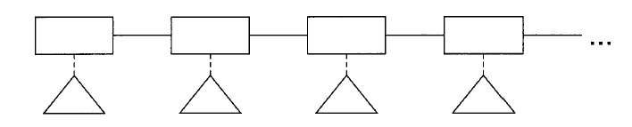
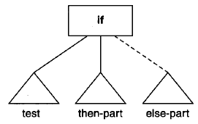
Syntax Tree Structure for the TINY Compiler
Basic syntax tree structures
1 A sequence of statements
2 An if-statement

Slide 8
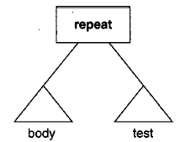
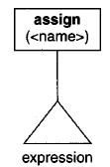
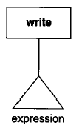
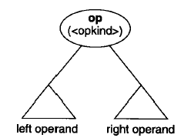
3 A repeat-statement
4 An assign-statement
5 A write-statement
6 An operator-expression

Slide 9
{sample program in TINY language- computes factorial}
read x;{input an integer}
if 0<x then {don’t compute if x<=0}
fact:=1;
repeat
fact:=fact*x;
x:=x-1
until x=0;
write fact{output factorial of x}
end

Slide 10
